Slide 1
The Energy Research Unit’s
Wind turbines
Jim Halliday
7th March 2018

Slide 2
Content
History of ERU
Previous wind turbines :
  VAWT 1978 – 1999
  Northwind 1983 - 2005
  Imperial College Wind turbine 1987 – 1997
  Windharvester 1990 - 2016
  Cretan Wind Turbine 1994 - 1997
  BUWT 1999 - 2016
ERU Test Site
Siemens Decoupled Green Energy
New wind turbine 2018

Slide 3
History of ERU
The Energy Research Unit was founded in 1978 - pioneering wind energy research in 1980’s and 1990’s used the ERU Test Site
Applied research in renewables (esp. wind, energy storage, solar, systems integration), hydrogen (systems, production, and Networking), energy sustainability
Near market R&D – use of outdoor test site - collaboration with industry/HEI partners
Funding : EPSRC, NERC, ESRC, EU, Industry, Govt Depts, TSB/InnovateUK
ERU staff played a key role in forming a professional association for UK wind energy, which became the trade association (RenewableUK). UK has 8,695 turbines (av size 2.1 MW) in Q2 2017 wind generated 13.4% of UK’s electricity

Slide 4
History – Vertical Axis Wind Turbine
Vertical Axis Wind Turbine (Musgrove Design); 4 kW, 6 m dia.
Built to go on a building in Cambridge – change of mind : came to RAL in 1978 => First post 1960 experimental wind turbine in the UK – vital inputs into debate whether wind turbines should be vertical or horizontal axis
Removed in 1999 to make way for the Building Integrated Wind Turbines (BUWT) concentrator

Slide 5
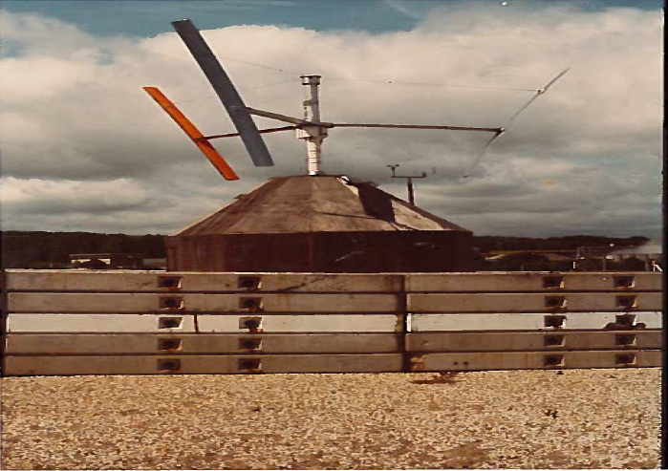
History – Vertical Axis Wind Turbine
1980

Slide 6
History - Northwind
North Wind L-916; 14 kW, 9 m dia, 2 bladed, downwind, passive pitch, variable or fixed speed, free yaw, 18.2 m tower.
Installed 1983 – American machine
Initially used in wind/diesel experiments then in projects modelling dynamically active wind turbines, rebuilt in 1996 (maintenance log records of that era report there were repeated problems with jackdaws making nests in the nacelle !)
Turbine dismantled - generator taken to Leicester University in 2005 for undergrad projects

Slide 7
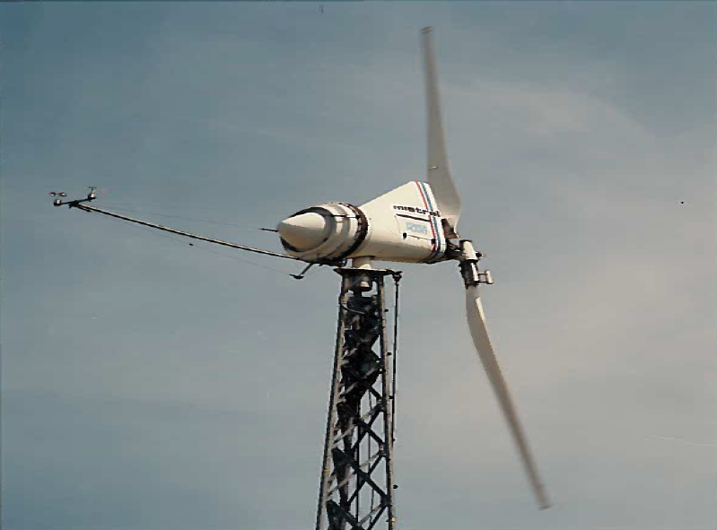
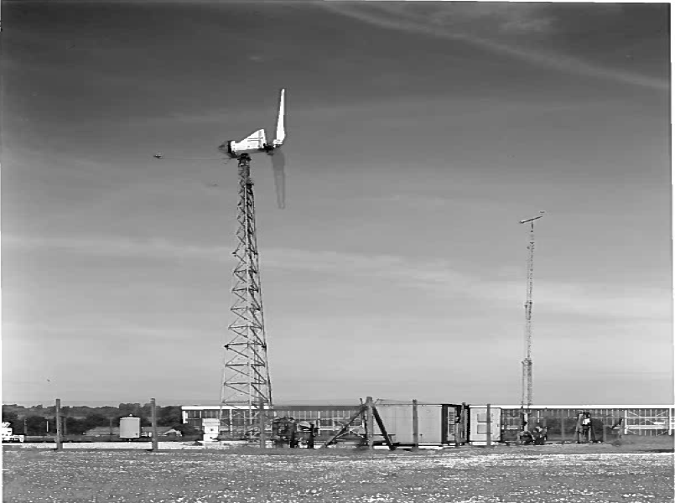
History - Northwind
1986

Slide 8
History – Imperial College Wind turbine
5kW, 6.5m diameter, 2 bladed, upwind, variable pitch and speed and yaw, 10m tower
Erected in 1987, used in various PhD projects esp aerodynamic control of blade pitch & rotor speed 1992-1994
Evolved through various designs, dismantled in 1997 and taken to Loughborough University….

Slide 9
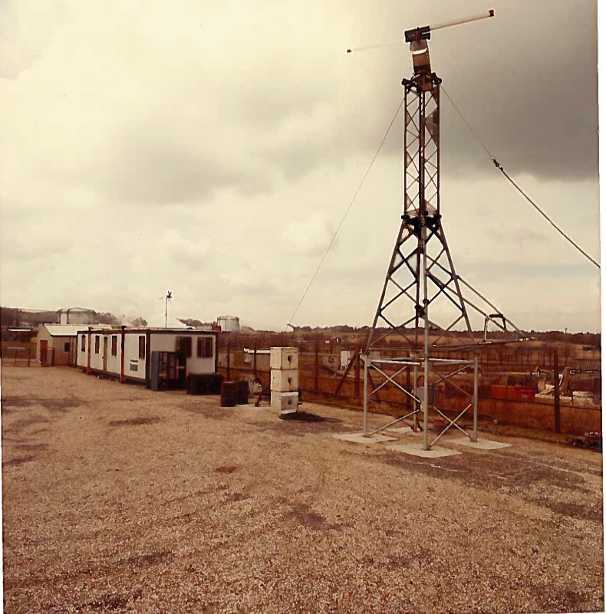
History – Imperial College Wind turbine
1987

Slide 10
History - Windharvester
Windharvester WH15/45 LM8.5; 45 kW, 17 m dia, 3 bladed, upwind, fixed pitch and speed, free yaw, 15 m tower. (Designed for high wind speed locations)
Erected in November 1990
Failure June 2000 – had generated 168,381 kWh – refurbished turbine raised in July 2002
Lowered 17 October 2016 - generation had ceased on 5 April 2016 due to nearby ground works for the Siemens Experiment – total in 23 years was 549,305 kWh but lots of down time….

Slide 11
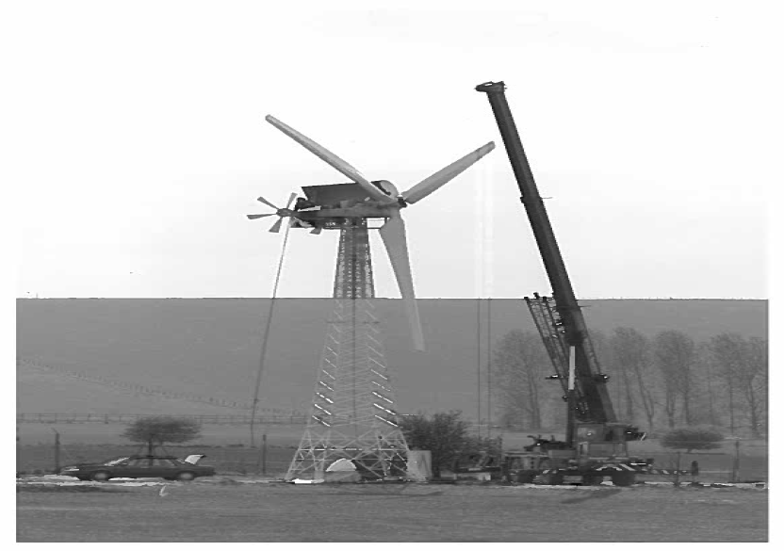
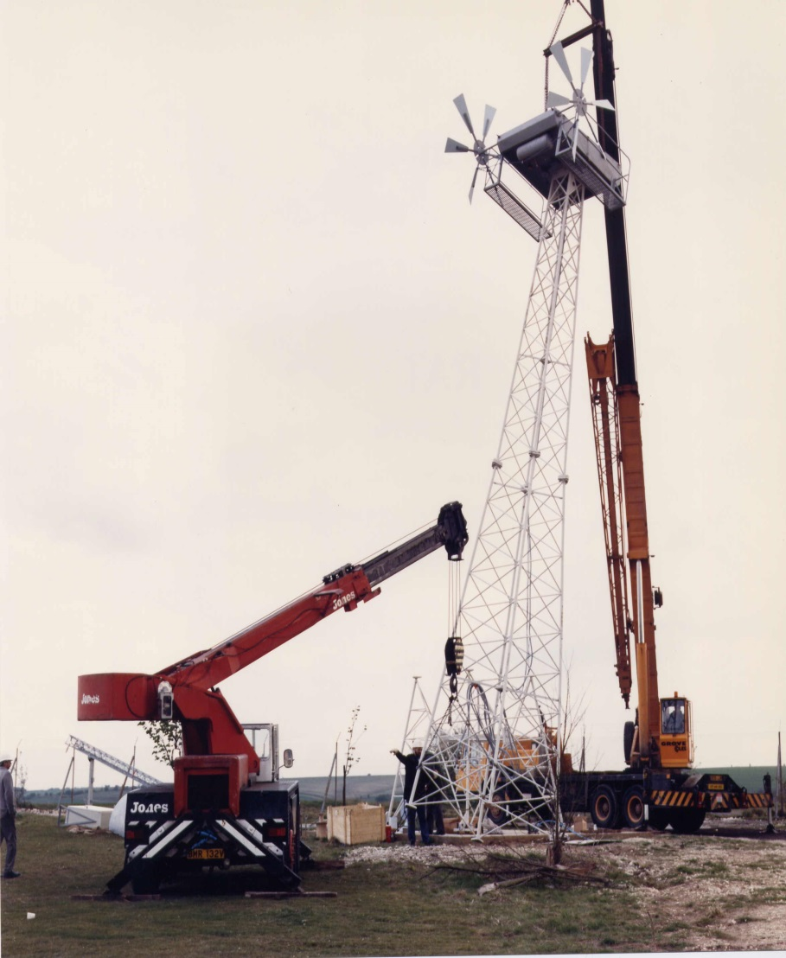
History – Windharvester - erection
1990

Slide 12
History – Windharvester - experiments
Wind-diesel system with a variable speed flywheel – Imperial College and industry 1992-1995
Pressure measurements with instrumented blade and in-hub PC – Imperial College 1992-1996
Flow visualisation around an operational wind turbine using particle image velocimetry – Heriot-Watt 1992-1993
Electro-dynamic braking – Manchester 1996-1997
Later years = generation into the RAL grid, and use as a PR tool – “lovingly” maintained for many years by Peter Anthony and Alan Ruddell

Slide 13
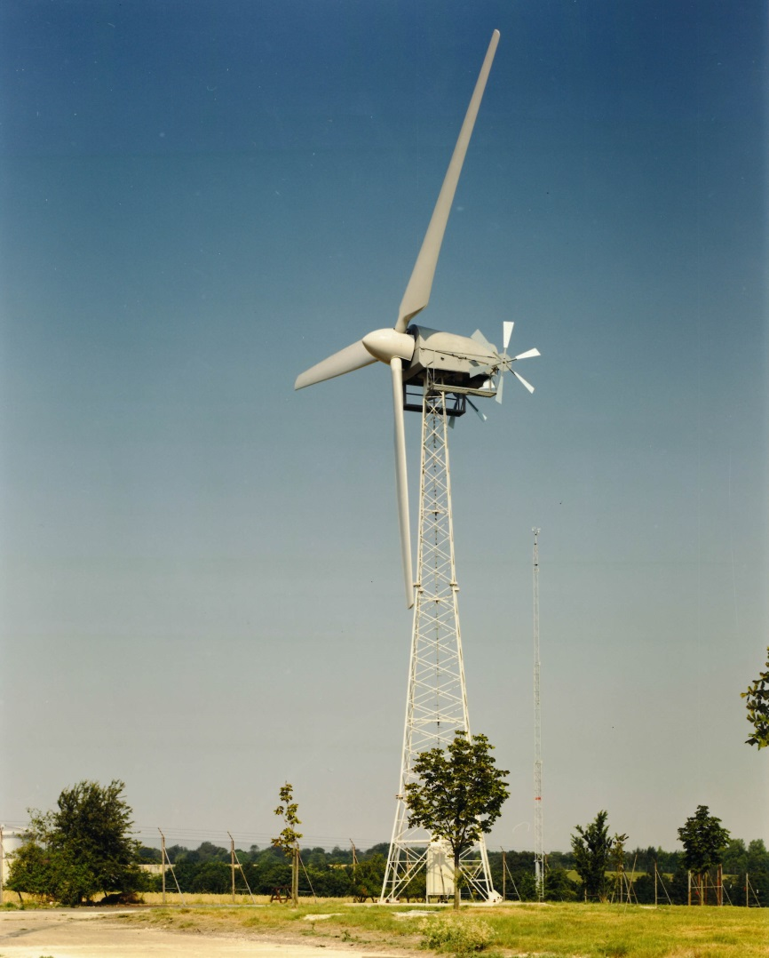
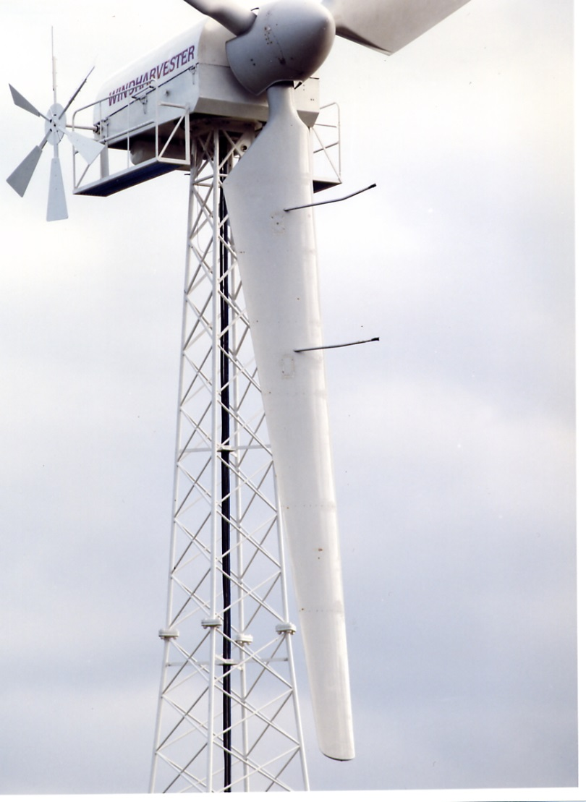
History – Windharvester
1996

Slide 14
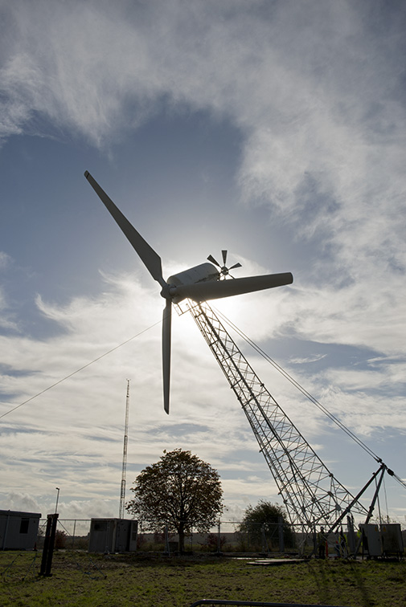
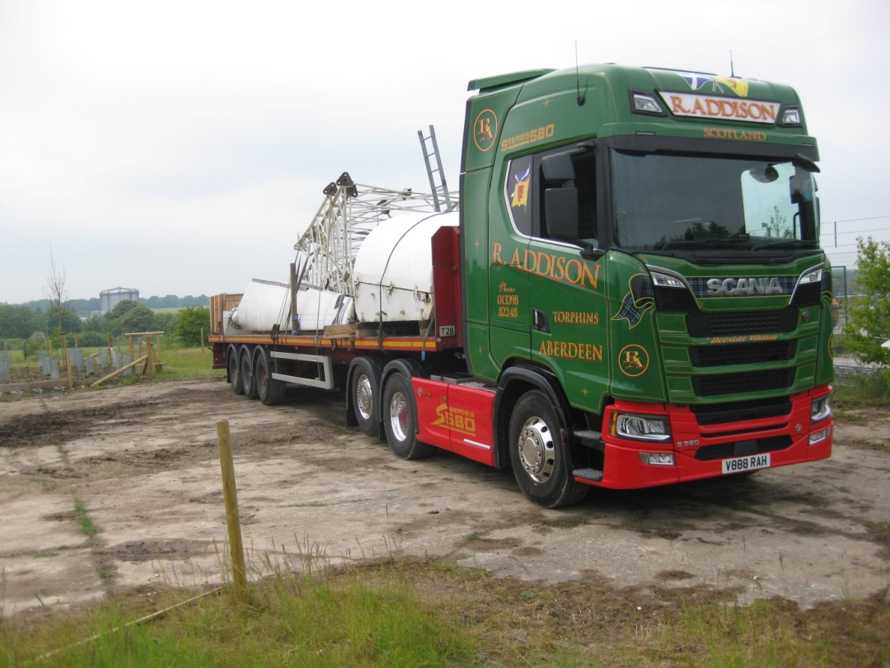
Lowering the Windharvester
Oct 2016
June 2018 – rehomed : Scotland

Slide 15
History – Sail Wing wind turbine
Imperial College Sail Wing Wind Turbine : 4kW, 6m diameter, 3 bladed (cloth sails), downwind, variable pitch and speed, free yaw, 9m tower
Aim – modern replacement of traditional turbines on Lasithi Plateau in Crete, and developing country use
Imperial College project 1992 onwards - installed at RAL 1994, experiments carried out, turbine relocated to Crete in 1997….

Slide 16
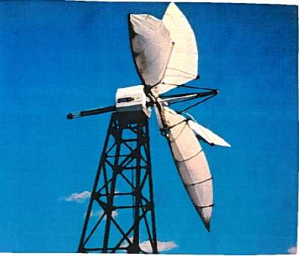
History – Sail Wing wind turbine

Slide 17
History – Building Integrated Wind Turbines
Hosted for Imperial College - input into an EU project in 1999 – accommodated very small vertical and horizontal access wind turbines – on a turntable so testing possible regardless of wind direction : purpose to evaluate the optimum design (in terms of energy enhancement) for integrating wind turbines in buildings
Dismantled when ERU Test Site relocated in 2016

Slide 18
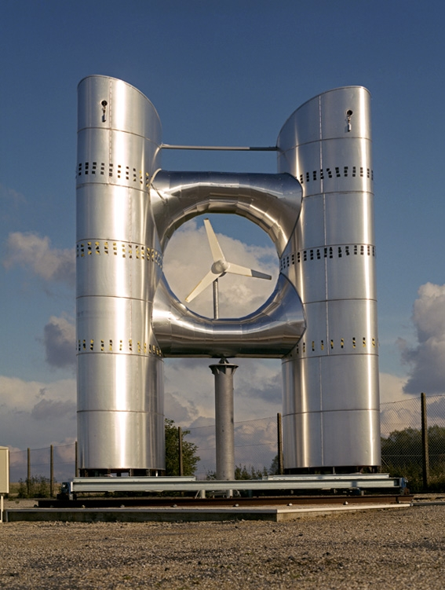
History – Building Integrated Wind Turbines

Slide 19
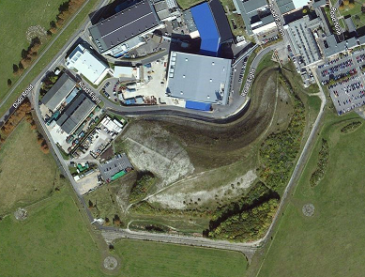
ERU Test Site - location
ERU Test site moved due to construction of 2 new buildings for ISIS R105 & R106 – Planning Permission granted in April 2015 – see here
New ERU Test Site
Site for Siemens Experiment

Slide 20
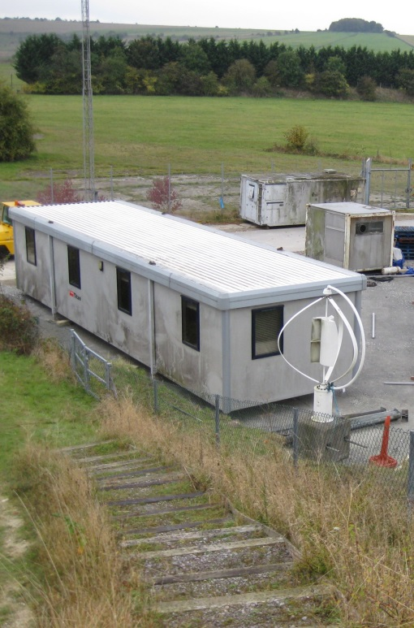
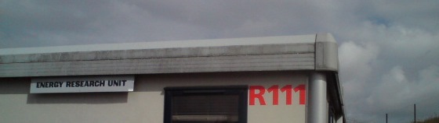
New ERU Test Site
Entire Test Site relocated 2016-2017,
New Control Room, Windharvester turbine dismantled
Weather station : instruments on existing mast, new logging system, some signals to Siemens experiment. http://www.elm.eru.rl.ac.uk

Slide 21
Siemens Decoupled Green Energy 2014-2018
£2M Siemens-led InnovateUK project involving University of Cardiff, University of Oxford, and ERU.
ERU’s role :
To provide a site for a “green” ammonia demonstration plant
To provide a supply of “green” electricity from the ERU Wind turbine

Slide 22
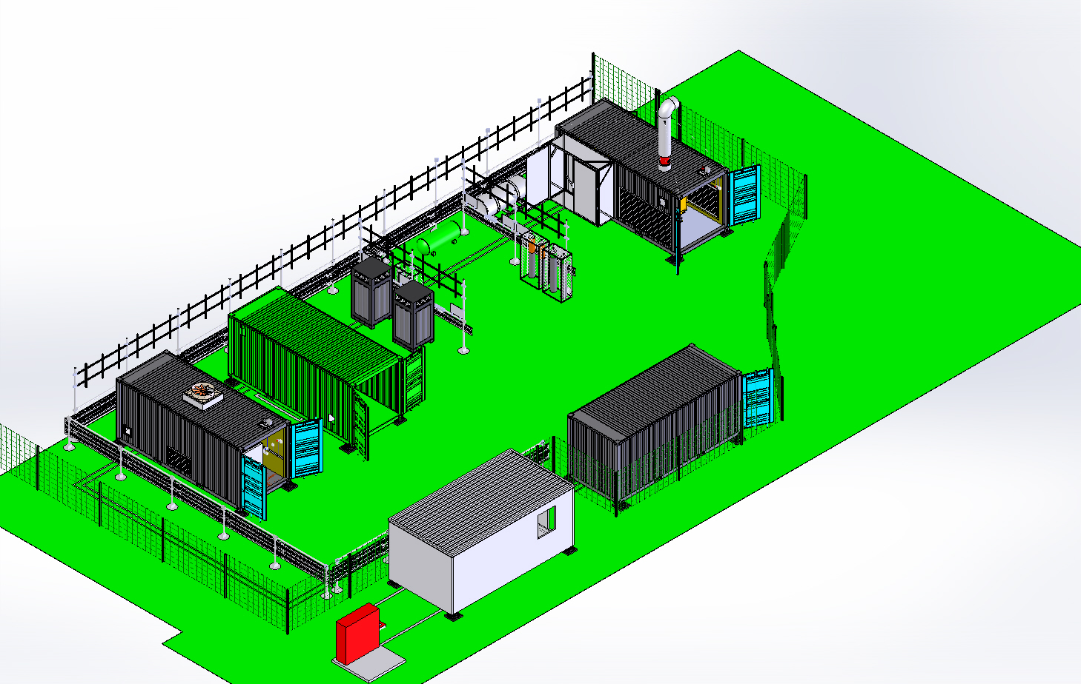
“Green” Ammonia Demonstrator

Slide 23
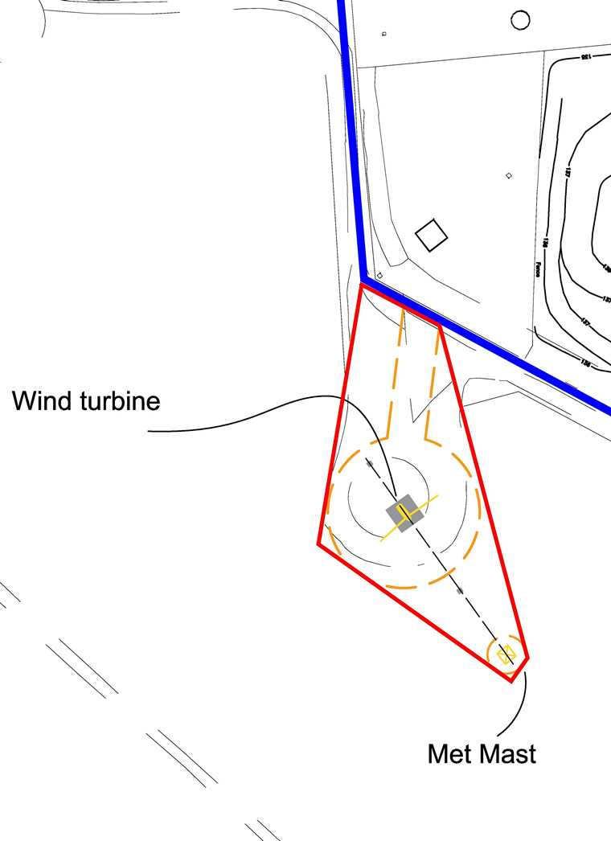
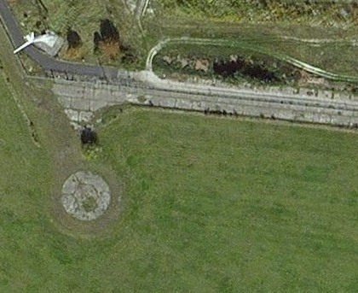
Wind turbine – Status (1)
  Turbine needed for Siemens Green Ammonia project
  STFC/UKAEA Rental agreement signed for adjacent land – the Windharvester site can be seen in the image below
xxxxxxXXxxx

Slide 24
Wind turbine - Status (2)
Windharvester
    Two quotes for installing Windharvester foundations and ducts obtained. Both were unacceptable in terms of cost and timescale. Decision taken to seek informal quotations for a new turbine ==> installed cost << than the foundation quotes !
  Revised Wind Turbine specification
    Specification drawn up for a 15 kW three bladed, upwind wind turbine optimised for a low wind speed site. Direct drive permanent magnet generator. Free-standing monopole hinged to allow erection and lowering using a hydraulic ram.

Slide 25
New wind turbine – Timetable - 2017
July : Spend-to-save funding possibility identified (Anna)
Aug : Market survey (Alan Ruddell)
Sep : Spend-to-save bid approved
Sep : Spec written, turned into tender (John Webber)
28 Sep : Tender issued
23 Oct : Tender closed (1 bidder)
17 Nov : STFC signed contract with Britwind Ltd (for a UK designed and made 15kW turbine)
20 Nov : Internal Britwind kick-off
28 Nov : Application made to SSE to connect
8 Dec : UKSBS order placed
18 Dec : Project plan received – inc Ordinance brief

Slide 26
New wind turbine – Timetable - 2018
3 Jan : Foundation digging started, foundation cage made, concrete poured on 15 Jan (planned dates 17 Jan - 30 Jan)
24 Jan : Started digging trenches
31 Jan : Electrical cabinet delivered
7 Feb : Cables installed (30 Jan)
20 Feb : Tower & nacelle delivered, construction team arrive (21 Feb)
21 Feb : Blades delivered and fitted (27 Feb)
22 Feb : SSE approval to connect received, turbine commissioned and connected to the grid (28 Feb)
On budget
On time
1046kW in 12 days

Slide 27
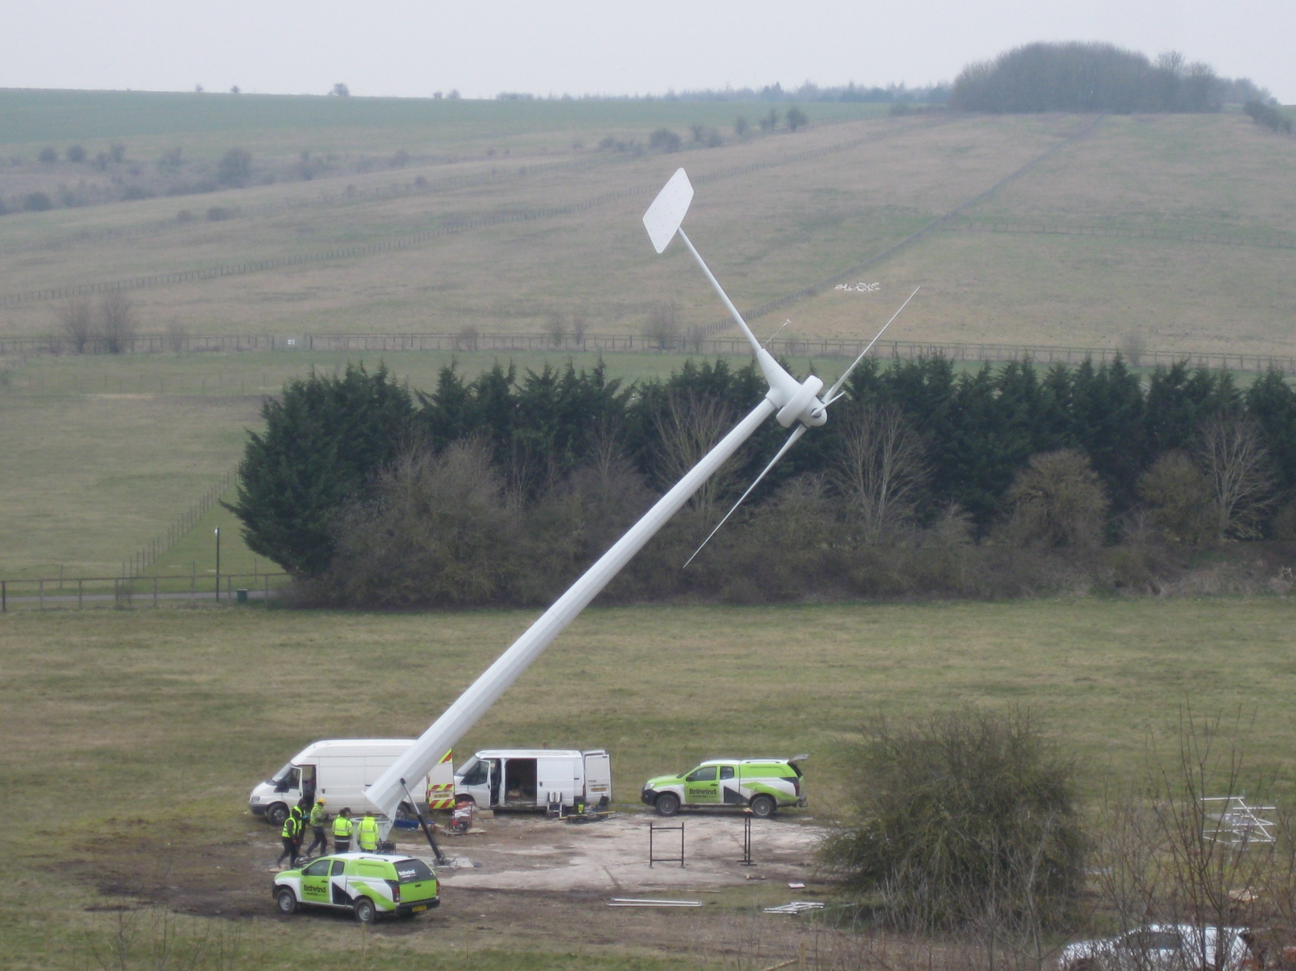
22nd Feb 2018

Slide 28
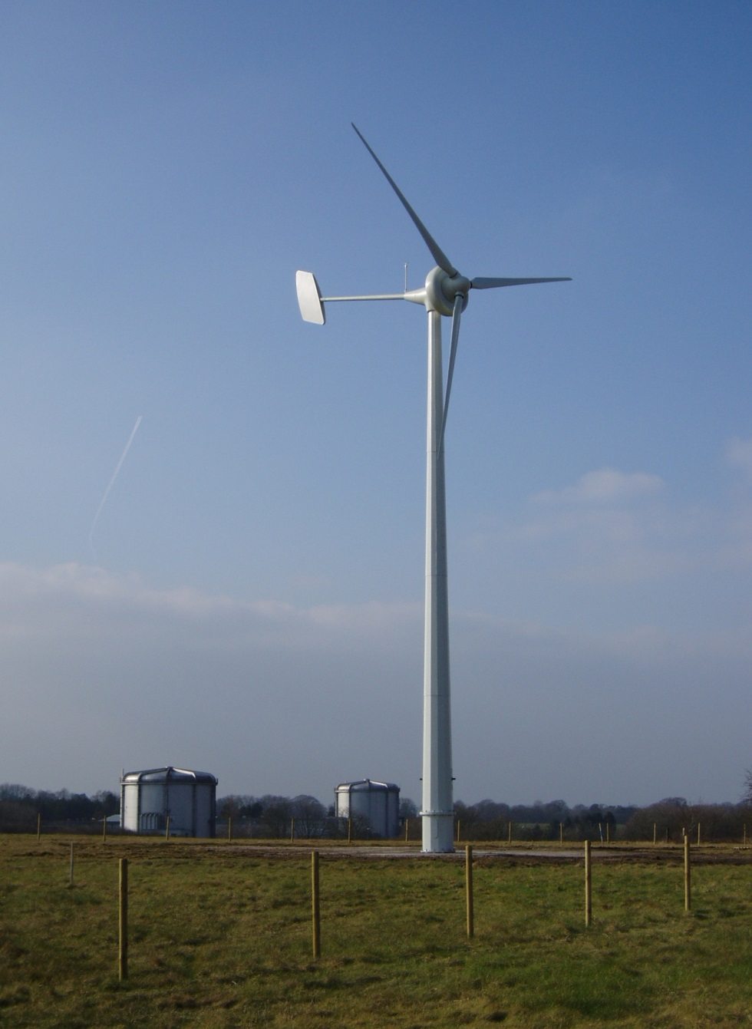
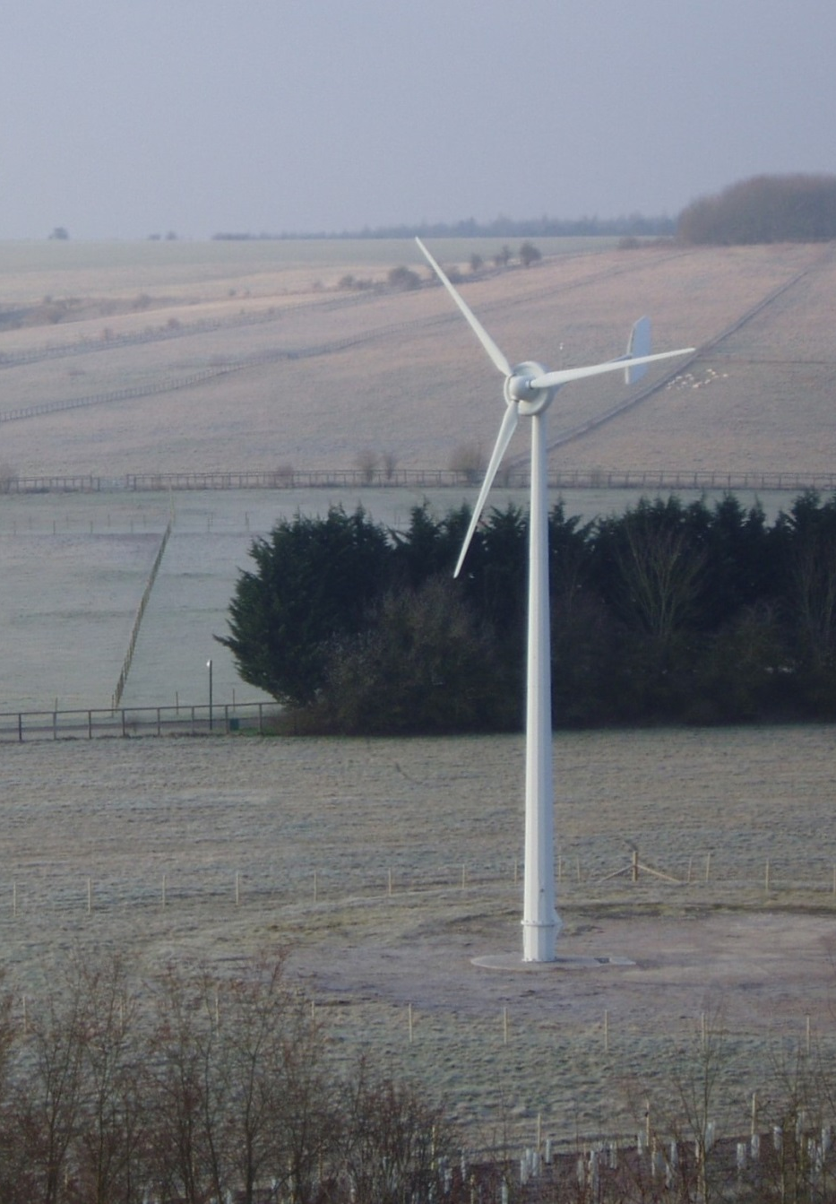
22nd and 23rd Feb 2018

Slide 29
The ERU’s innovative R&D programme continues….

